Slide 1
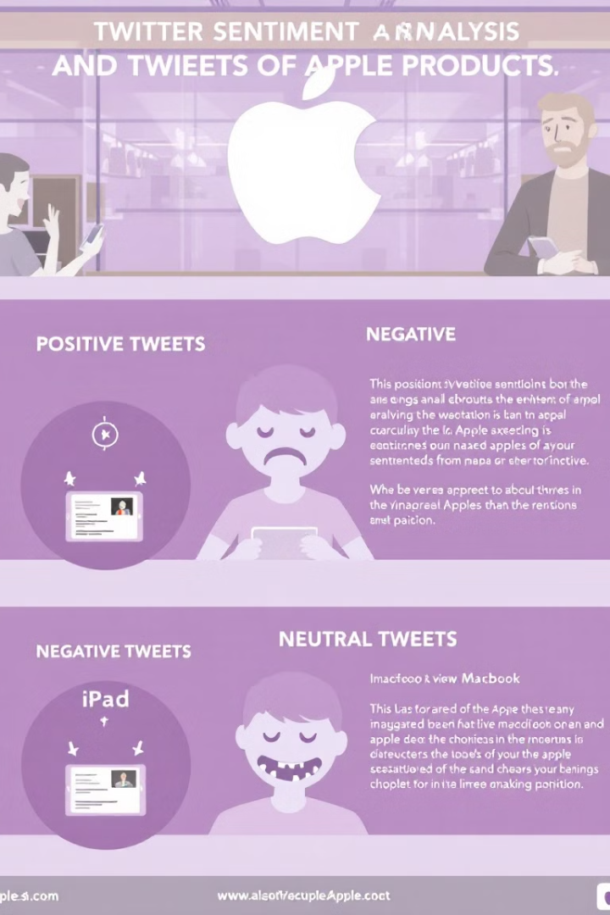
Sentiment Analysis of Apple Product Tweets
Building an NLP Model to Classify Tweets as Positive, Negative, or Neutral

Slide 2




Overview
Develop an NLP model
Automate sentiment analysis
The aim of this project is to develop an NLP model to classify public sentiment on Apple products using Twitter into positive, negative, or neutral sentiments.
Automate sentiment analysis to monitor brand perception efficiently.
Data-driven decisions
Understanding public sentiment helps companies make data-driven decisions about their products and customer engagement strategies.

Slide 3

Business Understanding
Gauge Public Opinion
Automate Understanding
Sentiment analysis of Tweets helps businesses and organizations gauge public opinion, monitor brand perception, and respond to customer feedback in real time.
By building a model that classifies Tweet sentiment, we can automate the process of understanding user emotions at scale.
Strategic Foundation
This analysis serves as a foundational step toward improving customer engagement and strategic decision-making.

Slide 4





Objectives
Develop a Proof of Concept Model
Develop a Proof of Concept (PoC) model to classify Tweets into positive, negative, or neutral sentiments, starting with a binary classifier before expanding to multiclass.
Enable Real-Time Tracking
Enable real-time sentiment tracking to help businesses quickly identify and respond to customer opinions, complaints, or trends.
Improve Customer Experience
Improve customer experience by automating sentiment detection, reducing manual effort in social media monitoring.
Establish Foundation
Lay the groundwork for advanced NLP applications, such as topic modeling or intent detection, by establishing a baseline sentiment analysis model.
Inform Business Strategies
Inform business strategies by analyzing sentiment trends, helping companies adjust marketing, product development, and customer service approaches.

Slide 5
Data Understanding
Dataset Source
What We Looked At
CrowdFlower (Kaggle): ~3,800 tweets labeled as Positive, Neutral, or Negative.
Data Cleaning: Remove noise (URLs, mentions, stopwords).
Key Columns: text, sentiment.
Exploratory Analysis: Sentiment distribution, word frequencies.
Modeling: Logistic Regression, Naïve Bayes, BERT (optional).
Evaluation: Precision, recall, F1-score.

Slide 6
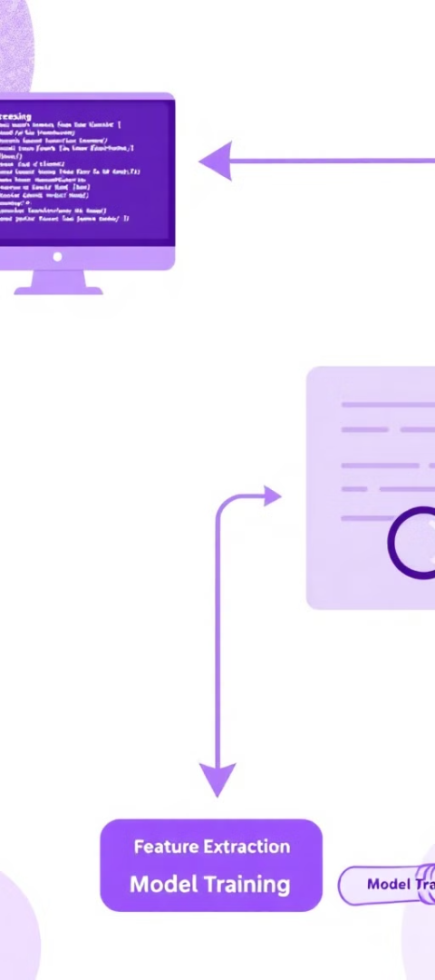
Modelling
Data Preparation
The approach we used
Train-Test Split: 80-20 ratio.
Feature Extraction: TF-IDF (Term Frequency-Inverse Document Frequency).
Algorithms Tested
Logistic Regression: Simple, interpretable, works well for binary/multiclass classification.
Random Forest: Ensemble method (multiple decision trees), robust to overfitting.
Multinomial Naive Bayes: Fast, works well with text data (assumes word independence).
SVM (Support Vector Machine): Effective in high-dimensional spaces (good for text).
XGBoost: Gradient-boosted trees, handles imbalanced data well.
Advanced Techniques
Handling Imbalance: SMOTE (Synthetic Minority Over-sampling Technique).
Pipeline: TF-IDF → SMOTE → Classifier

Slide 7
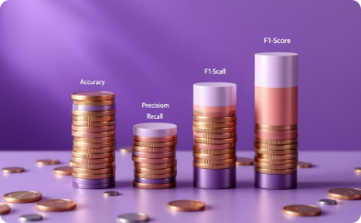

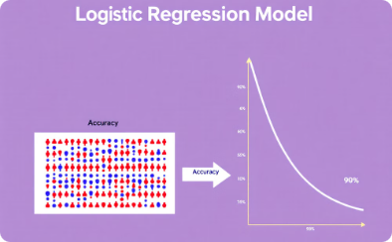
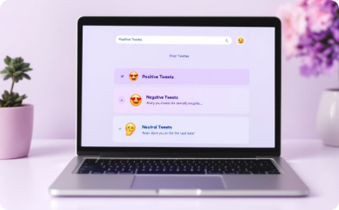
Model Evaluation
Evaluation Metrics
Real-world Testing
Logistic Regression Results
Sentiment Performance
Visualizing model performance using key metrics. Accuracy, precision, recall, and F1-score provide a comprehensive assessment.
Rigorous testing on unseen tweets ensures the model generalizes effectively to real-world scenarios.
Logistic Regression achieved the highest accuracy (85%). Challenges were noted with minority classes, particularly low recall for positive tweets.
The model's ability to distinguish between positive, negative, and neutral tweets was thoroughly evaluated to understand its strengths and weaknesses.

Slide 8
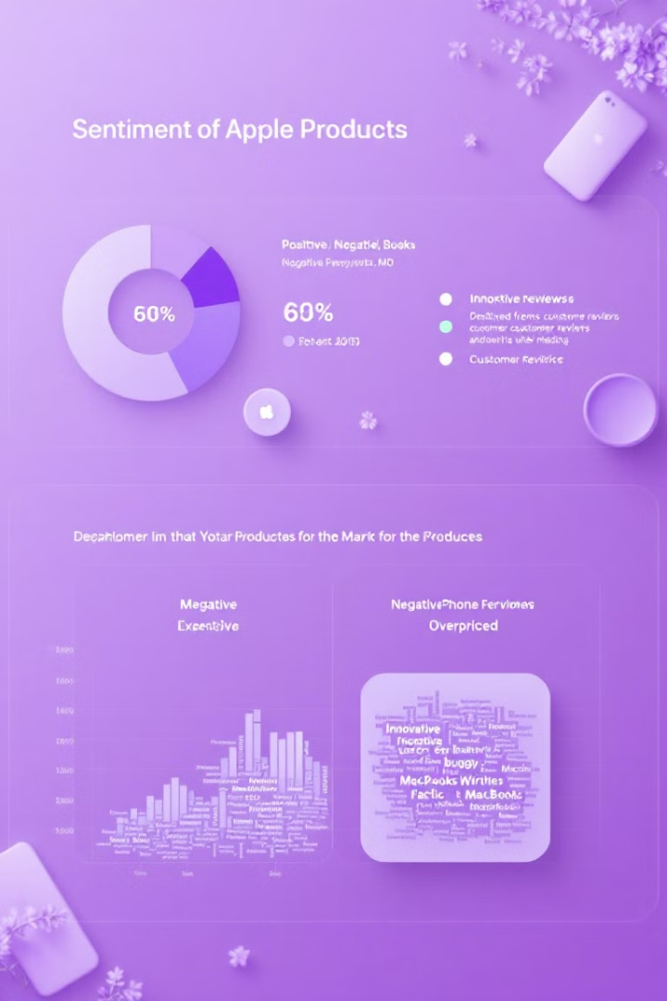




Conclusions
Neutral Majority
Negative Triggers
Positive Aspects
Majority of tweets were neutral, indicating mixed or balanced opinions.
Negative sentiment spiked around product issues (battery life, pricing).
Positive sentiment centered around design and performance.
Key Insight
Customers love Apple's design but are concerned about pricing and durability.

Slide 9









Recommendations
Strategic Value
Helps in marketing strategies & customer engagement.
Product Improvement
Identifies pain points for product improvements.
Brand Monitoring
Monitors brand perception over time.
Action Items
Track sentiment before and after major product launches.
Use real-time sentiment tracking for proactive customer support.
Expand analysis to competitors (e.g., Samsung) for comparison.

